Slide 1
Evaluation of Local Language Models for Medical Record Analysis
A comparative evaluation of Qwen, Llama, and Gemini models using PDSQI-9 based quality assessment.
Presented by: Cherish Uwandu
Collaborating Authors: David Liebovitz, MD
Department: Clinical Informatics
Summer 2026

Slide 2
Introduction
Medical records are information-dense. Patients' records contain large amounts of longitudinal and often complex clinical information. [1]
Large language models (LLMs) may improve access to this information. They are being investigated for tasks including medical question-answering, summarization, and clinical reasoning. [1]
Local LLMs offer potential advantages. Processing information directly on a device may improve privacy and reduce reliance on cloud-based services. [2]
However, smaller models require careful evaluation. Healthcare LLMs can produce inaccurate information, making evaluation of response quality and accuracy important before potential clinical use. [1]

Slide 3
Aim
To compare the response quality and accuracy of small local language models against a high-performing reference model when answering questions based on retrieved medical-record data.
Research Question
How do small local language models compare in response quality and accuracy across varying levels of medical-record question difficulty?

Slide 4
Methods: Testing Dataset Creation
Synthetic medical-record data and user questions of varying difficulty were generated using Gemini 3.1 Pro.
Each model received the same system prompt, chart data, and user question for all 30 synthetic patient cases, enabling a controlled comparison.
Questions and chart contexts were reviewed by a human for relevance, clarity, and answerability.
Three local models (Qwen 2.5 1.5B, Qwen 2.5 3B, and Llama 3.2 3B) and a reference model (Gemini 3.1 Pro) generated 120 total responses.

Slide 5
Methods: Model Evaluation
PDSQI-9–Derived Evaluation
The Provider Documentation Summarization Quality Instrument (PDSQI-9): Framework for evaluating LLM-generated clinical summaries. [3] Adapted here for medical-record question answering.
Claude Sonnet 4.6 evaluated each response using an adapted PDSQI-9 framework and the developers’ LLM-as-a-judge implementation.
Overall Response Quality: Mean of 6 dimensions including Accuracy, Thoroughness, Usefulness, Organization, Comprehensibility, and Succinctness.
The Abstraction and Synthesized dimensions were evaluated separately due to different scoring structures and/or conditional applicability.
Excluded dimensions: Citation (not applicable) and Stigmatizing language (all scores = 0).

Slide 6
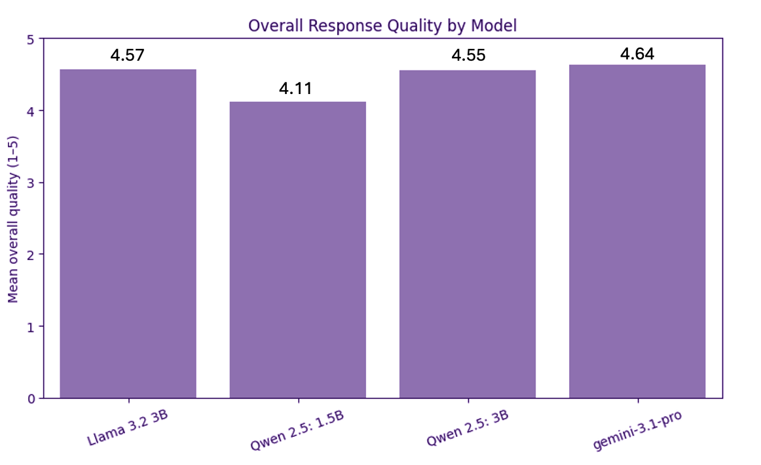
Results: Overall Response Quality
Overall response quality did not significantly differ between models.
(Friedman χ² = 5.19, p = 0.158).

Slide 7
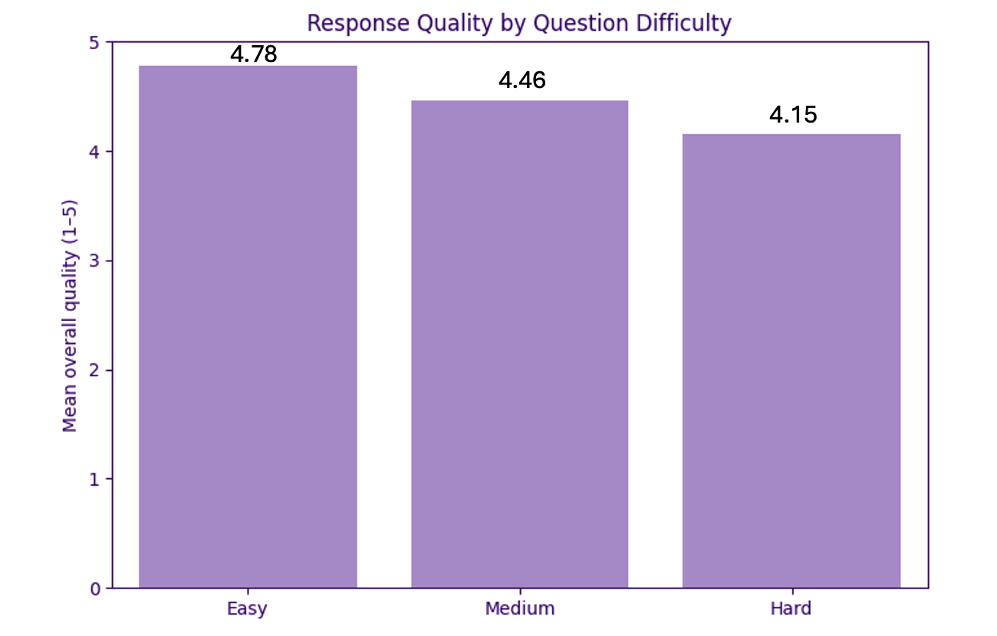
Results: Effect of Question Difficulty
Response quality significantly differed by question difficulty. Kruskal-Wallis H = 17.30, p < 0.001
Easy questions scored significantly higher than Medium (Holm-adjusted p = 0.0086) and Hard questions (p = 0.00068). Medium vs. Hard was not significant (p = 0.053).

Slide 8
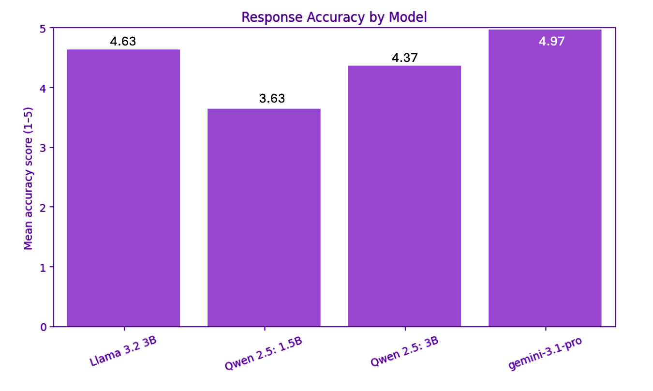
Results - Accuracy by Model
Accuracy significantly differed between models. Friedman χ² = 23.44, p < 0.001
The smallest local model had the lowest mean accuracy, while the reference model had the highest.

Slide 9
Qualitative Example
Question: My sleep apnea has been getting worse. Have I gained a significant amount of weight since my CPAP was originally titrated in 2020, and has my daytime oxygen saturation changed?
Model | Response Excerpt | PDSQI-9 Rubric | Accuracy
Qwen 1.5B | “You may experience an increase in snoring and pauses in breathing at night” | Unsupported assertion | 2/5
Qwen 3B | “I cannot determine if there was a significant weight gain...” | Misaligned assertion | 3/5
Llama 3.2 3B | “You have gained approximately 35 lbs... SpO₂ was 98%... most recent... 94%.” | Chart-supported assertions | 5/5
Gemini 3.1 Pro | “Your records track ‘SpO₂’, but they do not explicitly specify whether these readings were taken during the daytime or nighttime.” | Chart-supported; noted missing information | 5/5
Relevant chart evidence: OSA diagnosed March 10, 2020; CPAP titration study March 25, 2020. Weight increased from 210 lbs (April 1, 2020) to 245 lbs (December 20, 2023), while SpO₂ decreased from 98% to 94%. The chart does not specify whether SpO₂ readings were daytime or nighttime.

Slide 10
Conclusion
Local LLMs demonstrated high overall response quality, with no significant difference between models.
Question difficulty influenced response quality, with Easy questions receiving higher scores than Medium and Hard questions.
Accuracy differed significantly across models, with Gemini 3.1 Pro performing highest and Qwen 2.5 1.5B lowest.
Llama 3.2 3B was identified as the candidate local model for subsequent fine-tuning and evaluation.

Slide 11
Future Directions
Fine-tune the selected local model using the training dataset.
Re-evaluate the fine-tuned model using the held-out testing dataset.
Develop condition-specific fine-tuned models that can be swapped on-device.
Evaluate performance in the context of iPhone-based, local clinical question answering.

Slide 12

References
Wang, D., & Zhang, S. (2024). Large language models in medical and healthcare fields: Applications, advances, and challenges. Artificial Intelligence Review, 57, 299. https://doi.org/10.1007/s10462-024-10921-0
Wang, X., et al. (2025). Empowering edge intelligence: A comprehensive survey on on-device AI models. ACM Computing Surveys, 57(9), 228. https://doi.org/10.1145/3724420
Croxford, E., et al. (2025). Development and validation of the provider documentation summarization quality instrument for large language models. Journal of the American Medical Informatics Association, 32(6), 1050–1060. https://doi.org/10.1093/jamia/ocaf068
GitHub
Scan to access the GitHub repository.
Repository includes:
Synthetic chart data & evaluation questions
Model responses and evaluation results
Statistical analysis and visualization code
Project documentation and references

